Slide 1
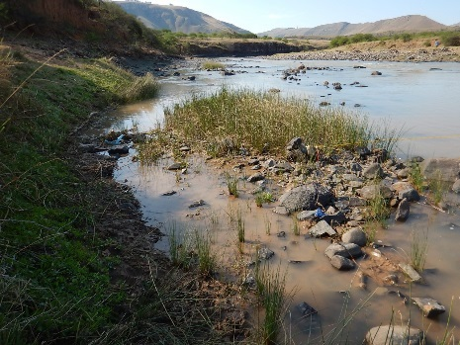
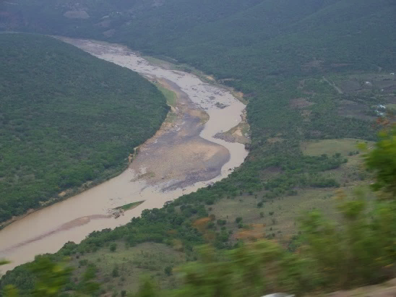
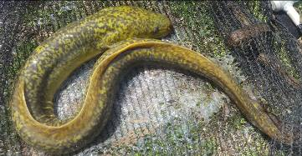


WP 11004: PMC MEETING 1,
22 NOVEMBER 2016
DETERMINATION OF WATER RESOURCE CLASSES AND RESOURCE QUALITY OBJECTIVES FOR THE WATER RESOURCES IN THE MZIMVUBU CATCHMENT

Slide 2
AIMS AND APPROACH
AIMS
Classify all significant water resources
Determine RQOs
Additional aim: Consolidate + undertake additional work on EWR and BHNR for the purposes of Classification
Timeframe: 24 months; Aug 2016-Juy 2018
Outcome: Gazetted Water Resource Classes and associated Resource Quality Objectives
According to the updated Integrated steps for WRCS and RQOs (DWS, 2016): Steps 1 – 7
  Steps 1 and 2 completed

Slide 3
PROJECT PLAN

Slide 4
STEPS 1 AND 2

Slide 5
STUDY PROGRAMME: GANTT CHART

Slide 7
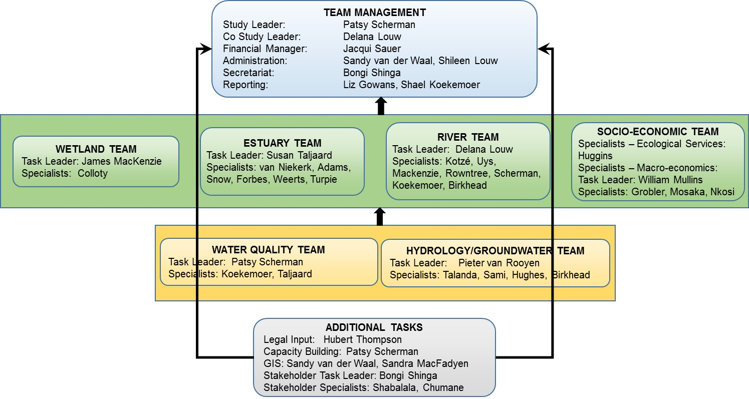
STUDY TEAM
One change to team: Ms Chumane has replaced Ms Jiyane on the SH team

Slide 8
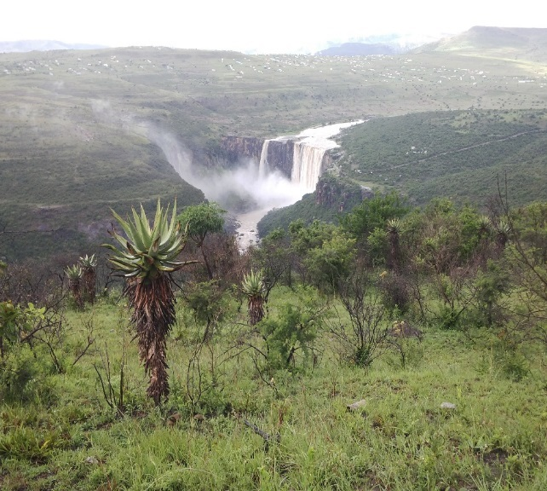
STUDY AREA (1)
Secondary catchment T3
Part of WMA7, i.e. Mzimvubu-Tsitsikamma WMA
Four main tributaries: Thina, Tsitsa, Kinira and Mzintlava rivers; and estuary at Port St Johns
  T31: Upper Mzimvubu
  T32: Mzintlava
  T33: Kinira
  T34: Thina
  T35: Tsitsa, Inxu (Wildebees)
  T36: Lower Mzimvubu
Main towns: Cedarville, Matatiele, Ugie, Maclear, Tsolo, Mount Fletcher, Mount Ayliff, Kokstad, Flagstaff, Tabankulu, Port St Johns
Free-flowing; ±70% communal land

Slide 9
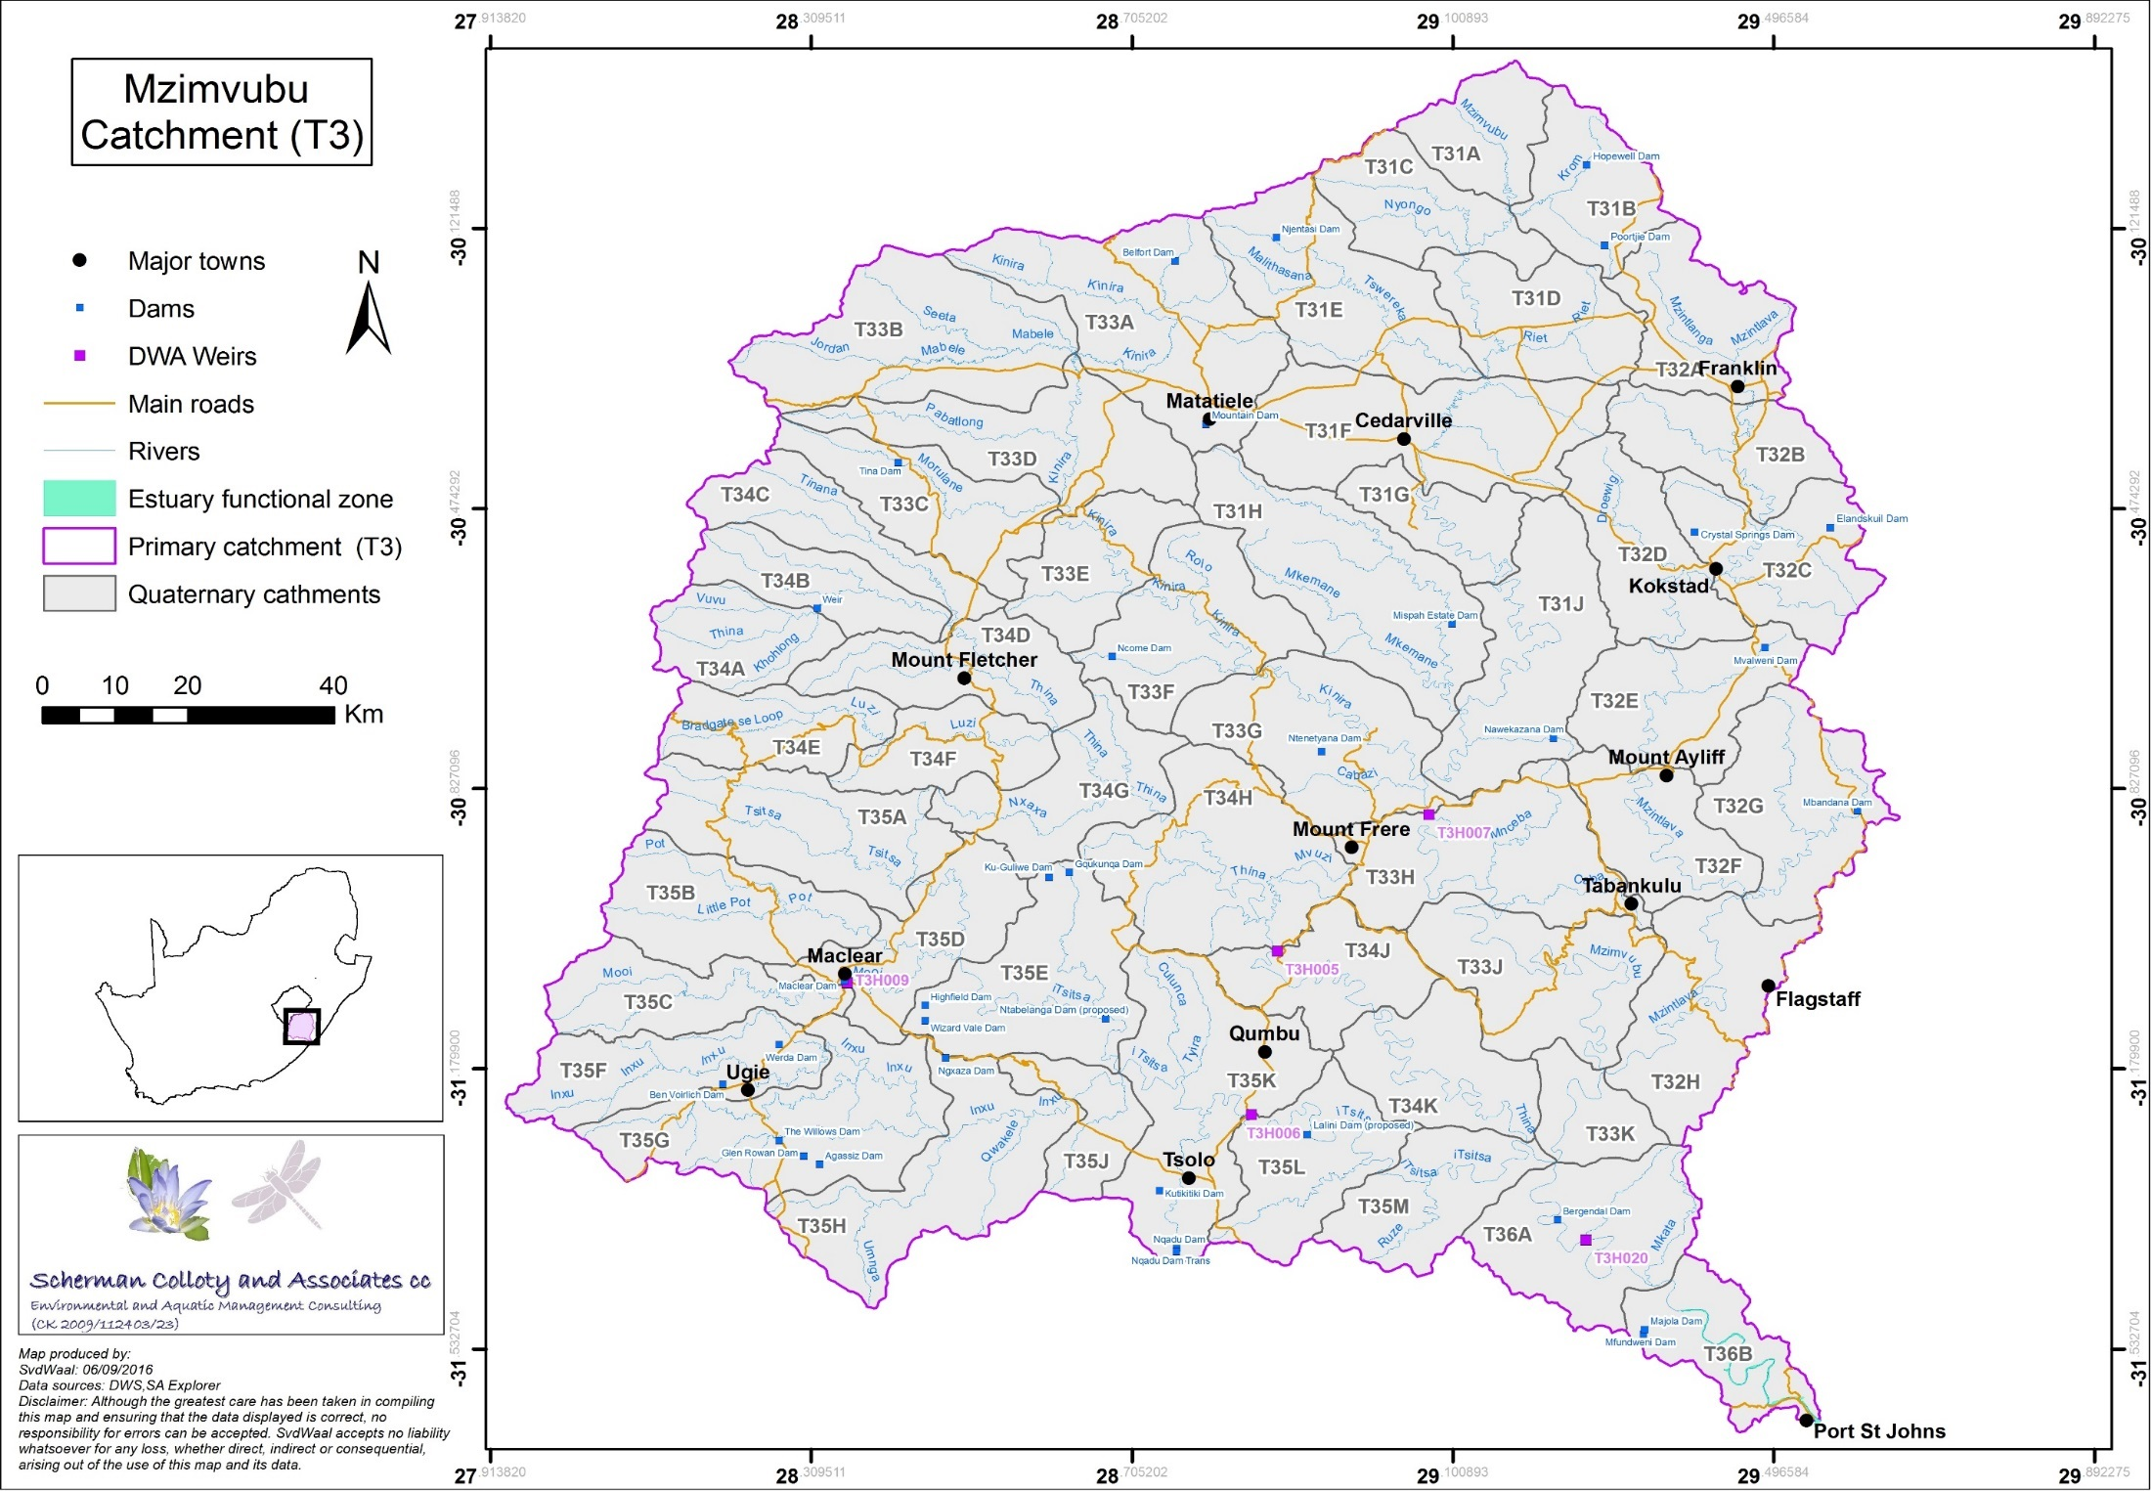

Slide 10
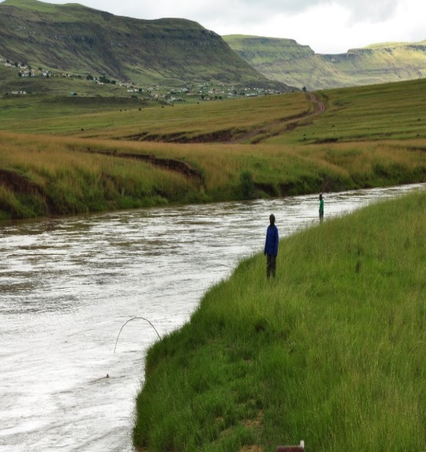
STUDY AREA (2)
Extensive wetlands around Matatiele, Cedarville, Franklin + Gatberg
Water quality generally good, although extensive erosion and sedimentation
Irrigation return flows + return flows from WWTW problematic in certain areas
Economically dominated by irrigation agriculture, commercial forestry, sawmills + laminated board factory
Prominent is the extent of dryland
cultivation
Little registered groundwater use
Key ecosystem services
  Recreational fishing
  Limited subsistence fishing
  Wastewater dilution

Slide 11
AVAILABLE INFORMATION (1)
Water resources
DWS WRYM configured for whole catchment by SA-EC Mzimvubu Development Project – used WR2005 hydrology
Updated for DWS dam Feasibility Study: Kinira and Tsitsa rivers
THIS STUDY: Use WRYM update for Kinira + Tsitsa; SA-EC information for rest of catchment. Incorporate updates on OR Tambo DM’s Ntsonyini Ngqongweni Regional Water Supply Scheme Phase 2 and 3, for Kuzeke tributary of the Mzimvubu
No primary hydrological studies will therefore be carried out and only available data and models will be refined to undertake analyses

Slide 12
AVAILABLE INFORMATION (2)
Reserve data
Feasibility Study Estuary Reserve assessment: information available + to be used
Existing river data from Inxu (Wildebees) + Gatberg Reserve studies to be used
Feasibility Study River Reserve assessment:
  raw data still not available for the Ntabelanga-Lalini study
  data not at Classification level for all sites (e.g. Rapid III methodology; no floods; no ecological consequences step; no site on main stem)
  Field survey of 19-22 September 2016:
    Sites now all at Intermediate level (MzimEWR1-3)
    Additional site surveyed on the lower Mzimvubu downstream of gauging weir T3H020 (MzimEWR4)

Slide 13
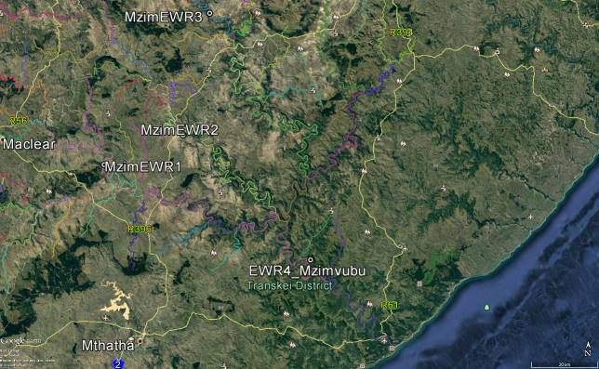
Data collected
Habitat integrity
Fish
Macroinvertebrates
Riparian vegetation
Geomorphology
Hydraulics
Water quality (incl diatoms)

Slide 14
AVAILABLE INFORMATION (3)
Wetlands
Feasibility Study wetland data available for Ntabelanga-Lalini area, but no wetland assessments as part of the Reserve component
Other wetland information available for the area to be used
Groundwater
The MWP’s Water Resources Report has a desktop review; focus on aquifer types, yields + water levels; water supply problems
Little info on water balances + gw contribution to the EWR. No gw chapter or report in Feasibility Study
Surface-gw interactions need to be evaluated
Gw contribution to the EWR to be assessed

Slide 15
MANAGEMENT AND STAKEHOLDER ENGAGEMENT
Five PMC meetings
Four PSC meetings
A public meeting at two venues at end of study
Technical Task Group (TTG) meetings, as needed
  Proposed: Wq TTG meeting at end Jan/early Feb 2017
Sector meetings, as needed
Communication strategy
  Study announcement (advertisements) √
  Preparation (√) and distribution of the BID
  Preparation of the Initial Stakeholder Database √
  Preparation of the Stakeholder Engagement Plan by DWS PM √
  Invitation to the Inaugural PSC meeting √
  Information updates throughout study

Slide 16
PROPOSED MEETING SCHEDULE (1)
PMC 1: November 2016
PMC 2: March 2017
PMC 3: June 2017
PMC 4: November 2017
PMC 5: May 2018
PSC meeting 1: end November 2016 (now 5 Dec 2016)
Status quo assessment ; delineation of RUs + IUAs
Identification of priority areas, EWR sites and desktop biophysical nodes
PSC meeting 2: April 2017
Desktop and River EWRs, including EcoClassification results
Systems modelling
Selecting and defining operational scenarios

Slide 17
PROPOSED MEETING SCHEDULE (2)
PSC meeting 3: July 2017
Estuary EWR results
Wetland EcoClassification
Groundwater report
PSC meeting 4: November 2017
Consequences of operational scenarios (estuary, river, economics, ecosystem services, user water quality)
Presentation of Preliminary WRC
Stakeholder/Public meetings: March 2018
Feedback on final WRC for gazetting
Draft RQOs
Three TTG meetings
User water quality
Input to MCA used for scenario evaluation
RQOs

Slide 18
PROPOSED CAPACITY BUILDING PROGRAMME
A mentorship programme is also proposed for Mr Mulangaphuma

Slide 19
SCOPE OF WORK: TECHNICAL (1)
TASK 1: DESCRIBE STATUS QUO AND DELINEATION
  Status quo description: Water resources, Ecosystem services, Macro-economics, Rivers, Estuary, Wetlands, Groundwater, Water quality
  RU and IUA delineation: Groundwater Resource Units, Prioritising of river RUs (Ecological Importance, Socio-cultural Importance, Water Resource Use Importance, Water quality), Estuary is one RU
TASK 2: QUANTIFY EWRs
  Systems modelling and River Desktop EWRs
  EWRs at detailed level
  Estuary EWR
  Basic Human Needs Reserve (ground + surface water BHNR)
  Groundwater
  Wetlands

Slide 20
SCOPE OF WORK: TECHNICAL (2)
TASK 3: IDENTIFICATION AND EVALUATION OF SCENARIOS
  ID and yield modelling of scenarios: DWS input + signing off of scenarios NB
    Selection of scenarios should be limited to options currently being planned for implementation in the next 10-16 years
    REC flows will be included as an extreme option
    Five scenarios (other than PD and Natural)
    Can only be evaluated with Rapid or higher EWRs
  Scenario consequences: Economics, ecosystem services and non-ecological (user) water quality
  Scenario consequences: River and estuary ecology
Note: It is assumed no scenarios will impact on wetlands, hence no wetland consequences included. Specialist work only previously undertaken for riverine wetlands

Slide 21
SCOPE OF WORK: TECHNICAL (3)
TASK 4: DETERMINATION OF DRAFT WATER RESOURCE CLASSES
  Multi-criteria analysis (MCA) spreadsheet approach will be applied
  Input required: Work session with DWS to discuss proposed Target Ecological Categories (TECs) per EWR site, estuary + biophysical node
TASK 5: RESOURCE QUALITY OBJECTIVES
  Estuary RQOs
    Set for flow, hydrodynamics, water quality, sediment processes, microalgae, macrophytes, invertebrates, fish and birds
  Non-ecological (user) water quality RQOs
  Wetland RQOs for priority wetlands per wetland type
  Groundwater RQOs

Slide 22
SCOPE OF WORK: TECHNICAL (4)
TASK 5: RESOURCE QUALITY OBJECTIVES (cont.)
  River RQOs
    Set for hydrology, water quality, habitat and biota
    RQOs will be identified for each RU according to priority level:
      Low priority: EcoStatus as a minimum with estimated EWRs (hydrology RQO) where available.
      Moderate priority: EWR (hydrology RQO) and water quality as numerical information (if data are available) and narrative for habitat and biota.
      High priority: All components as numerical data if information is available.
TASK 6: IMPLEMENTATION AND MONITORING

Slide 23
SCOPE OF WORK: COMPLETION + LEGAL
TASK 7: SUMMARY REPORTS AND ELECTRONIC DATA
TASK 8: PREPARE INFORMATION FOR GAZETTING + MANAGE REVIEW PROCESS
  Gazetting will address WRC and RQOs
  DWS study officials to submit for internal approval
  Technical comments to be addressed by PSP during 60d comment period
  No additional studies will be undertaken to address issues
Information required:
Liaison of legal expert with DWS regarding legal requirements well before 2018
A template from the DWS for preparation of the Classification and RQO gazette

Slide 24
FINANCIAL MANAGEMENT + REPORTING
Invoicing is final deliverable based, as specified in the contract
A progress report / cover letter will accompany each invoice, together with the final deliverable
Cash flow expenditure is shown in the month the invoice is delivered, so as to link with the GANTT chart for the study
Reporting is as follows:
  Deliverables invoiced indicated on a Deliverables Table
  Cash flow expenditure as a Cash Flow Projection graph
Two invoices have been delivered to date
  Reporting shown on subsequent slides for current project progress

Slide 25
Deliverables
Table

